Slide 1



To develop a CNN model to classify images of plastic waste into different categories
Presented By: Yasmeen Begum

Slide 2

Learning Objectives
Ability in Data Handling
Proficient in Data Visualization
Image Processing
Knowledge on Fundamentals of Deep Learning
Model compiling and evaluating
Enhancing Performance
Predicting Organic or Recycled using Gradio
GOAL
Source :
www.freepik.com/

Slide 3
Tools and Technology used
Python
Tensorflow
Keras
Pandas
OpenCv
Numpy
Matplotlib
Seaborn
Gradio

Slide 4
Methodology
Data collection
Data Visualizations
Model Building
Data Augmentation
Data Generators
Model Training
Performance Visualization
Model Evaluation
Gradio Interface

Slide 5
Problem Statement
To develop a CNN model to classify images of plastic waste into different categories.
Objective:To create an accurate CNN model for plastic waste classification.
Background:Plastic waste poses significant environmental concerns.
Scope:Use a dataset, preprocess images, build and train a CNN, and evaluate its performance.
Expected Outcomes:A high-accuracy CNN model for classifying plastic waste images.
Impact:Enhancing waste sorting efficiency and supporting sustainable waste management

Slide 6
Solution
Data Collection and Preparation:
Download Dataset:
path = '/kaggle/input/waste-classification-data'
Image Loading:
Convert images to RGB: img_array = cv2.cvtColor(img_array, cv2.COLOR_BGR2RGB)
Labels: ['Organic', 'Recyclable’]
Data Visualization:
Label Distribution:
Pie chart with labels=['Organic', 'Recyclable']
Sample Images:
Displaying 9 random images from the dataset.

Slide 7
Model Building:
Define Model Architecture:
Conv2D: Extracts features from images using convolution operations (e.g., Conv2D(32, (3,3), input_shape=(224,224,3))).
MaxPooling2D: Reduces spatial dimensions by downsampling feature maps (e.g., MaxPooling2D(pool_size=(2, 2))).
Flatten: Converts 2D feature maps into a 1D vector for fully connected layers (e.g., Flatten()).
Dense: Fully connected layer for classification (e.g., Dense(256, activation='relu')).
Dropout: Randomly drops neurons to prevent overfitting (e.g., Dropout(0.5)).
Compile Model:
loss="binary_crossentropy", optimizer="adam", metrics=["accuracy"]

Slide 8
Data Augmentation:
Training Data Augmentation:
rotation_range=40, width_shift_range=0.3, height_shift_range=0.3
Validation Data Augmentation:
Similar augmentation techniques as training data.
Data Generators:
The `train_generator` and `test_generator` create batches of augmented images from the respective directories, resizing them to 224x224 pixels, in RGB color mode, and using categorical class mode for classification.'
Model Training:
10.Early Stopping:
-patience=5, baseline=0.4
11.Train Model:
-epochs=16

Slide 9
Performance Visualization:
12.Accuracy and Loss Plots:
-Plotting history.history['accuracy'] and history.history['val_accuracy’]
-Plotting history.history[‘loss'] and history.history['val_loss’]
Model Evaluation:
13.Confusion Matrix:
-Confusion matrix visualization using seaborn heatmap.
14.Calculate Metrics:
-Accuracy,precision_score,Recall,F1-score
Gradio Interface:
15.Define Prediction Function:
-img_resized = np.reshape(img_resized, [-1, 224, 224, 3])
16.Create Gradio Interface:
-demo = gr.Interface(fn=predict_waste, inputs=gr.Image(type="numpy"), outputs=gr.Textbox())

Slide 10
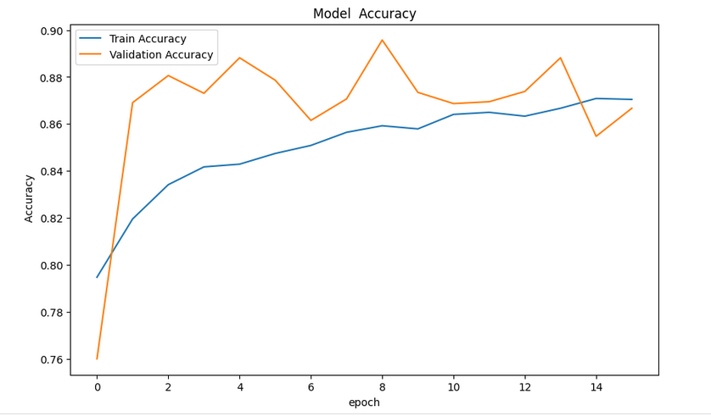
Screenshot of Output
Model Accuracy Graph

Slide 11
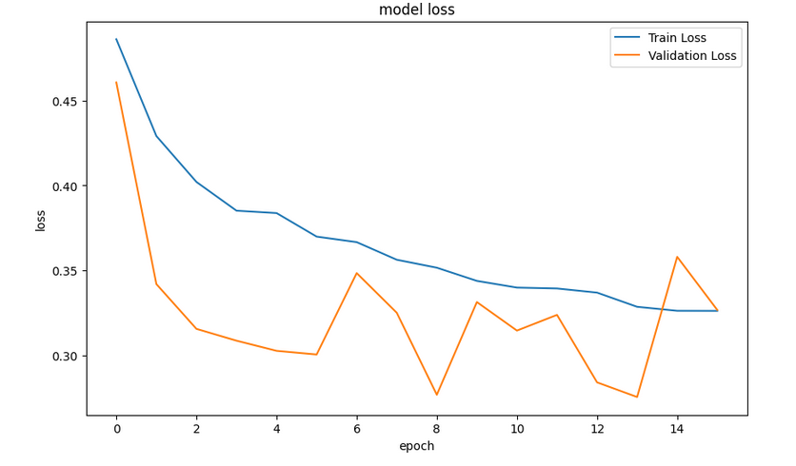
Model Loss Graph

Slide 12
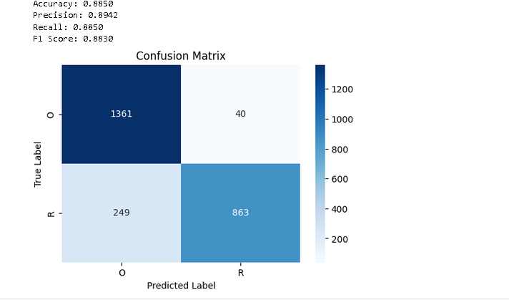
Model Evaluation Metrics

Slide 13
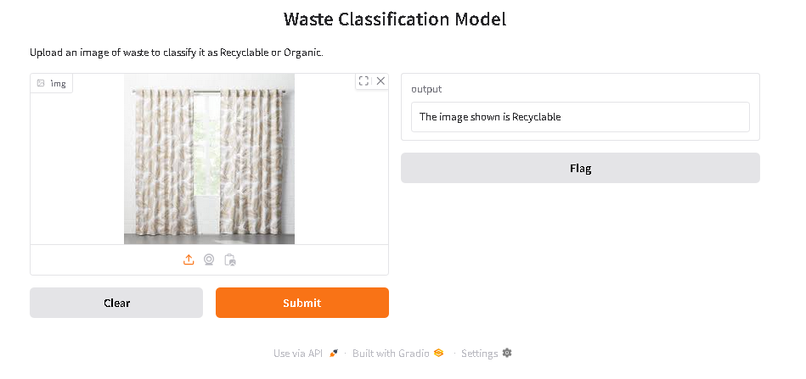
Gradio Interface Predicting Image as Recyclable

Slide 14
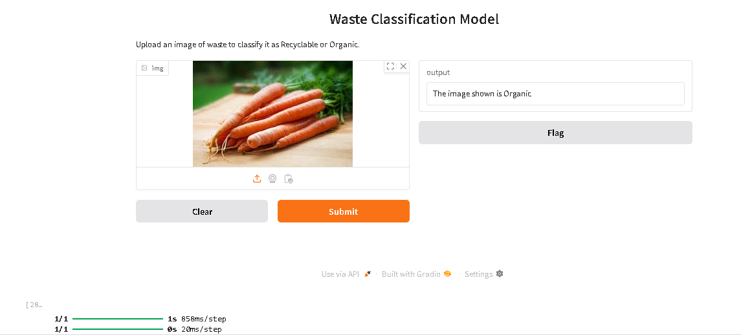
Gradio Interface Predicting Image as Organic

Slide 15
Conclusion:
The waste classification model, trained over 16 epochs, has demonstrated good results in accurately classifying images of plastic waste into organic and recyclable categories
The model's performance, as indicated by metrics such as accuracy, precision, recall, and F1 score, shows that it effectively learned to distinguish between different types of waste.
This successful implementation highlights the potential of using Convolutional Neural Networks (CNNs) for improving waste management and recycling processes.
With further fine-tuning and validation, this model can significantly contribute to efficient and automated waste classification, leading to more sustainable environmental practices.

